Slide 1

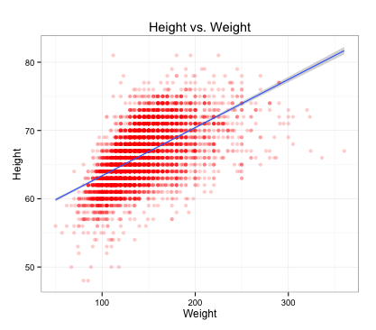
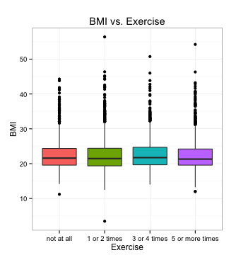
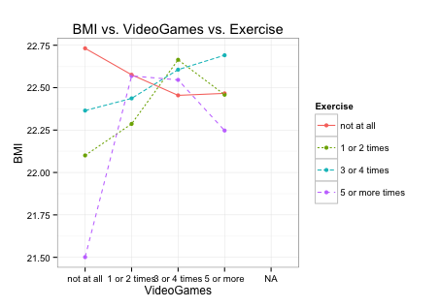
How Videogames and Exercise Affect BMI By Olivia Herder
Introduction
Results continued
This project uses the AddHealth data set to explore a possible correlation between BMI, hours spent exercising and hours spent playing video games. The AddHealth data set was composed of students from high schools all over the United States. During the first phase of this study, students were asked questions pertaining to their daily lives.
This once again suggests that there is no relationship between BMI and exercise. The results of graph three shows that the participants with the lowest BMI do not play video games and they exercise 5 or more times per week. The participants with the highest BMI do not exercise at all, but they also do not play videogames. This suggests that videogames and BMI do not have as strong as an association because the results are all across the board.
Methods
Graph one shows the relationship between the height and weight of the cohort. This information was used to determine their BMI. Graph two shows the relationship between a person’s BMI and how often they exercise. Graph three shows the relationship between BMI, and how often a person plays video games and exercises.
Further Research
All of this information indicates that other factors, such as nutrition, television exposure, sleep , socioeconomic status, and family life may play a more important roles in BMI.
Results
References
After performing an analysis of variance test, the p value was found to be 0.3238. This shows that there is no association between the BMI of the cohort and how many times a week they exercise. This means that there is insificant evidence to support the alternative hypothesis. The results of graph two show that the average BMI for each level of exercise is consistent.
Berning, Joshua, Rui Huang, and Adam Rabinowitz. 2014. “An Evaluation of Government and Industry Proposed Restrictions on Television Advertising of Breakfast Cereals to Children.” Journal of Consumer Policy 37 (4): 507–25. doi:10.1007/s10603-013-9233-1. http://0-search.ebscohost.com.wncln.wncln.org/login.aspx?direct=true&db=bth&AN=99108895&site=ehost-live.
Beyens, Ine, and Steven Eggermont. 2014. “Putting Young Children in Front of the Television: Antecedents and Outcomes of Parents’ Use of Television as a Babysitter.” Communication Quarterly 62 (1): 57–74. doi:10.1080/01463373.2013.860904. http://0-search.ebscohost.com.wncln.wncln.org/login.aspx?direct=true&db=a9h&AN=94318349&site=ehost-live.
Chahal, H., C. Fung, S. Kuhle, and P. J. Veugelers. 2013. “Availability and Night-Time Use of Electronic Entertainment and Communication Devices Are Associated with Short Sleep Duration and Obesity Among Canadian Children.” Pediatric Obesity 8 (1): 42–51. doi:10.1111/j.2047-6310.2012.00085.x. http://0-search.ebscohost.com.wncln.wncln.org/login.aspx?direct=true&db=a9h&AN=84637230&site=ehost-live.
Kar, Subhranshu Sekhar, Rajani Dube, and Sitanshu Sekhar Kar. 2014. “Childhood Obesity-an Insight into Preventive Strategies.” Avicenna Journal of Medicine 4 (4): 88–93. doi:10.4103/2231-0770.140653. http://0-search.ebscohost.com.wncln.wncln.org/login.aspx?direct=true&db=a9h&AN=98496275&site=ehost-live.
Philips, Nele, Isabelle Sioen, Nathalie Michels, Ester Sleddens, and Stefaan De Henauw. 2014. “The Influence of Parenting Style on Health Related Behavior of Children: Findings from the ChiBS Study.” International Journal of Behavioral Nutrition & Physical Activity 11 (1): 1–23. doi:10.1186/s12966-014-0095-y. http://0-search.ebscohost.com.wncln.wncln.org/login.aspx?direct=true&db=a9h&AN=97363130&site=ehost-live.

